Slide 1
Smoke-Free Multiunit Housing
February 21, 2018
Elizabeth Anderson-Hoagland, MPH
Policy Analyst

Slide 2
Agenda
Rationale for smoke-free policy
Policy options
Enforcing smoke-free policies (Kentucky Center for Smoke Free Policy)
Resources available (American Lung Association)
PHA Panel

Slide 3
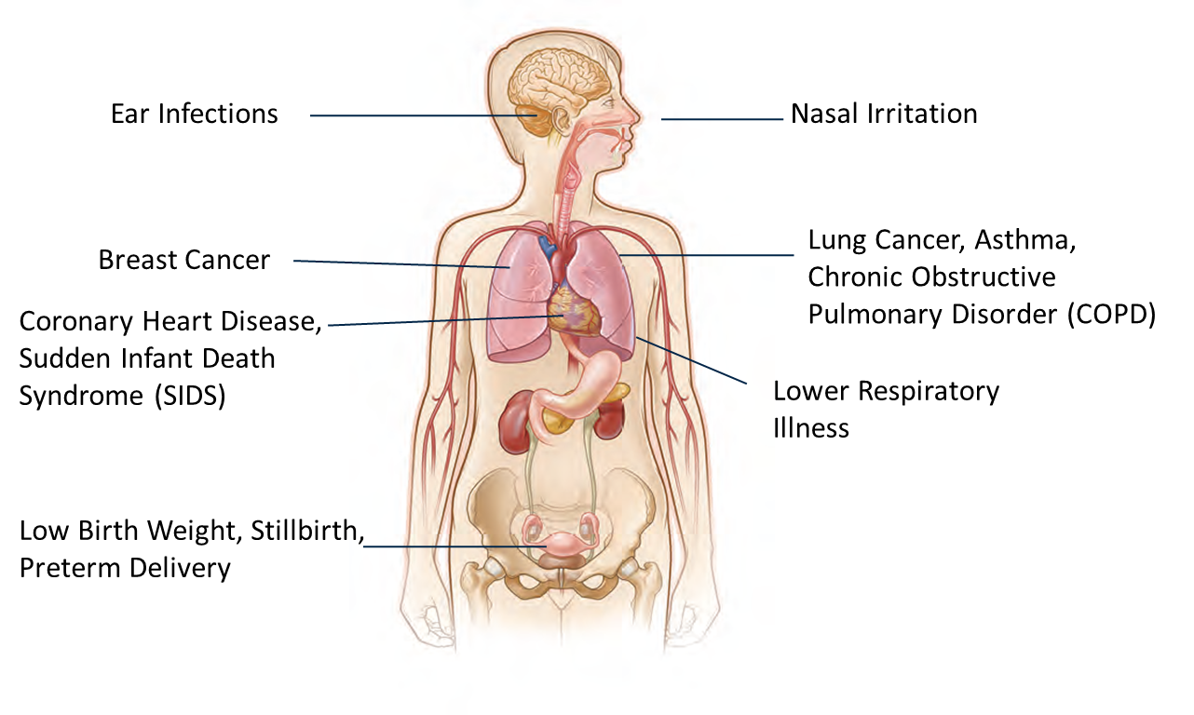
Secondhand Smoke Exposure
1964
Notes:
Source The health consequences of smoking – 50 years of progress: a report of the Surgeon General. – Atlanta, GA. : U.S. Department of Health and Human Services, Centers for Disease Control and Prevention, National Center for Chronic Disease Prevention and Health Promotion, Office on Smoking and Health, 2014.
Children: poor socialization, learning difficulties, and more aggressive behavior.
International Agency for Research on Cancer – nonsmokers exposed to secondhand smoke in the workplace have a 16-19% increase risk for lung cancer. Involuntary smoking increases the risks of an acute coronary heart disease event by 25-35%. Diabetics who smoke have increased difficulty controlling their blood sugar or A1C.

Slide 4
Notes:
In addition to the impact of secondhand smoke exposure on people, animals can also be harmed by secondhand smoke exposure. Animals exposed to secondhand smoke are more likely to develop cancers and respiratory problems.

Slide 5
Notes:
In buildings without restrictions, smoke from common areas or other units where smoking occurs can seep into your home.
National Center for Chronic Disease Prevention and Health Promotion, Office on Smoking and Health Feburary 3, 2015
Often residence living in multi-unit housing may open their windows hoping for a breeze only to receive a big gust of secondhand smoke from someone smoking outside the building or in an apartment below. There is no way to protect yourself or loved ones from secondhand smoke once it enters the air. Fans, air fresheners, and air purifiers are all poor defenses against secondhand smoke.
Secondhand smoke can not be contained.
Secondhand smoke can travel through ventilation systems, open windows, and under doors.
Opening a window, spraying air freshener, or turning on a fan does not remove the toxins contained in secondhand smoke from the air.

Slide 6
Kentucky Smoking by Education and Income
25.9%
28.2%
37.9%
26.9%
16.5%
KY BRFSS 2015
*HS=High School; GED=General Educational Development
Notes:
It’s important to note that even though some groups have higher rates of smoking, like lower educational attainment or lower socioeconomic status, most people do not smoke. Even in Kentucky.

Slide 7
Case Study: Covington Housing Authority

Slide 8
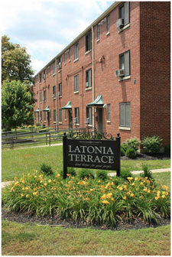
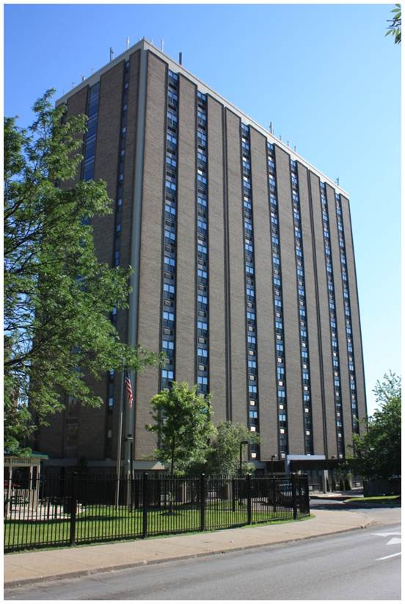
Case Study: Housing Authority of Covington
4 Conventional public housing sites
Over 800 units
1,674 residents
400 youth age 0 -5
Notes:
Data from Housing Authority of Covington (2013)

Slide 9
Resident Support
Support for Smoke-Free Housing by Housing Community
HAC Community | Support | Do Not Support | No Response | Total | Support % | Do Not Support %
Golden Tower | 10 | 17 | 1 | 28 | 35.71% | 60.71%
City Heights | 59 | 46 | 0 | 105 | 56.19% | 43.81%
Latonia Terrace | 54 | 29 | 1 | 84 | 64.29% | 34.52%
57% of all residents supported smoke-free policy
Notes:
In addition to the results related to smoke-free housing there were some further results that HAC staff found to be informative and helpful to their work. The survey responses indicated that 13% of those surveyed had lived in a HAC community for 20 years or longer and an additional 14% had lived there for 5-10 years. This statistic was concerning to HAC staff as it shows people are not moving towards self-sufficiency; rather the HAC communities are permanent homes to many. The survey also indicated that 34% of respondents do not have health insurance which shows the need for an effort from the HAC to assist residents in obtaining health insurance. The two largest responses for why individuals do not see a doctor when they need to were, cost (20%) and lack of transportation (20%). These results prompted discussion by HAC staff on what could be done to reduce these barriers in order to assist people in seeing a doctor when it is needed. Another alarming response for HAC staff was that 41% of respondents go to the emergency room for care when they or a family member are sick or hurt. This percentage is very high and shows the need for further education and assistance in connecting with care sources other than the emergency room for residents. The HAC staff indicated that these results would be used to assist in efforts to change these statistics as well as would be helpful in writing grant applications to receive assistance to cover transportation and co-pay costs related to residents receiving care from a physician.
Data from Housing Authority of Covington (2013)

Slide 10
Key Results
Pre-Policy
Post-Policy
Notes:
Data from Housing Authority of Covington (2013)

Slide 11
Key Results
Pre-Policy
Post-Policy
Notes:
Data from Housing Authority of Covington (2013)

Slide 12
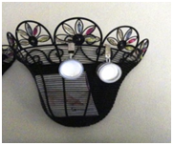
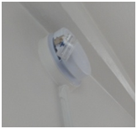
Air Nicotine Testing
Partnership with Johns Hopkins University
Purpose: to monitor air nicotine levels in residential units, common areas and office spaces
$25 incentive
Air Nicotine monitors in homes
Notes:
-$65 each, passive air nicotine monitor $5,000 for analysis from Johns Hopkins
-Devices that monitor nicotine are the best because nicotine is a unique chemical that cannot be detected by most other devices
-These devices are preferable to a particle monitor like a Side pak or dylos because particles are not unique to secondhand smoke, but nicotine is. A person cooking in an apartment can create as much smoke as cigarettes can, and it is not possible to distinguish between the two with a simple particle monitor

Slide 13
Pre-Policy Results
Detectable levels of air nicotine were found in all buildings, in every type of dwelling, workspace and common area.
Average Air Nicotine = 4.103 µg/m3
Notes:
Because there is no safe level of SHS the concentration of nicotine in the environment should be zero (ie, undetectable). Any level of exposure increases health risk, although the risk is substantially higher with increasing concentrations
Data from Housing Authority of Covington (2013)

Slide 14
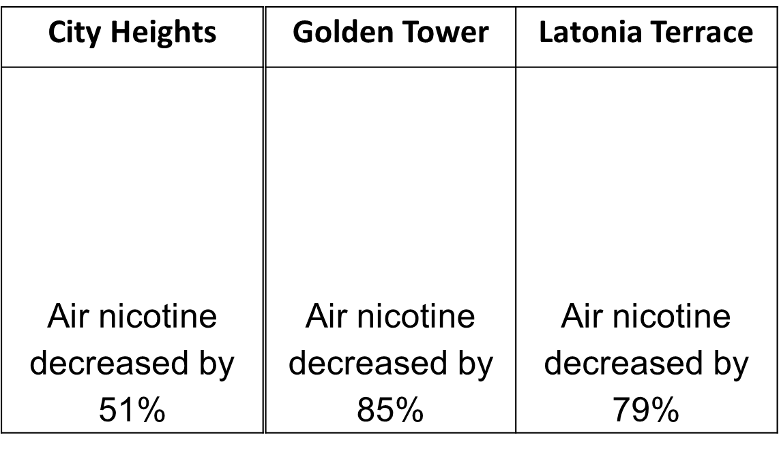
Post-Policy Results
There was a 75% overall reduction in air nicotine
Notes:
Data from Housing Authority of Covington (2013)

Slide 15
Total Turnover Cost
Unit Size | Non-Smoking | Smoking | Percent Difference
1 Bedroom | $839.50 | $1,594.83 | 62%
2 Bedroom | $1,232.11 | $1,874.57 | 41%
3 Bedroom | $1,355.16 | $2,147.79 | 45%
4 Bedroom | $1,644.85 | $2,844.28 | 53%
Notes:
Data from Housing Authority of Covington (2013)
Turnover of smoking apartments requires an increase in staff time and a greater need to replace certain materials, such as upholstery, carpet and curtains.

Slide 16
Policy Suggestions

Slide 17
Determine the Scope of the Policy
Policy Requirements
All public housing units
All interior spaces
Outdoors within 25 ft of dwelling units and administrative buildings
Enhancements
Areas outside of the 25 ft requirement, such as playgrounds, sidewalks, etc.
Designate all exterior grounds smoke free, except designated smoking areas
Designate all exterior grounds smoke free

Slide 18
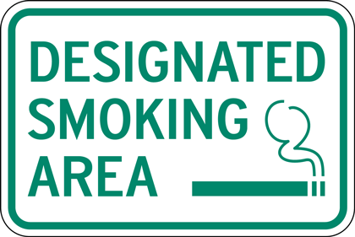
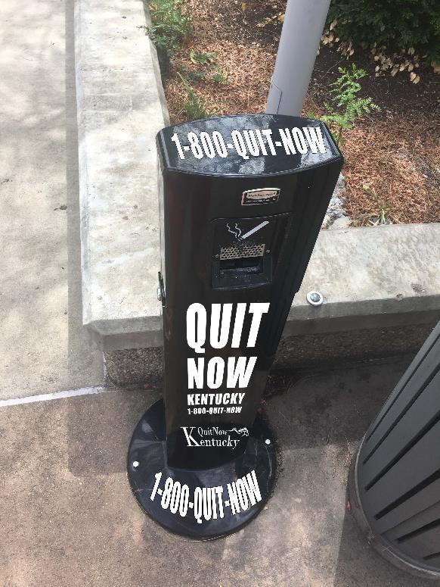
Notes:
A designated smoking area may make sense, depending on the layout of your grounds and the number of residents you have who smoke.
A DSA may increase compliance with the policy, as enforcement is easy. You don’t have to determine if the resident is 25 feet from the exterior building. You just know they can only smoke at the DSA. This will also limit creep, as smokers creep closer and closer to the buildings. A DSA may be easier to keep clean, as all butts and other litter will be confined to one area and provided ashtrays can reduce litter even further.
HUD allows use of capital funds to build structures, such as gazebos, for protection from the weather.
If you have a DSA, you’ll want to provide the proper receptacles for tobacco liter. This will keep the area looking nice and reduce the risk of fires from lit cigarettes being thrown in to trash cans or dry leaves. I am particularly fond of this one…

Slide 19
Notes:
How many of you have playgrounds on property? Or areas where children congregate to play? We all care for our children, so protecting children from secondhand smoke exposure, especially while they’re running around, is always a popular option. This can make enforcement challenging, depending on the layout. Where does the playground begin and end? Where will parents go to smoke if the children are playing?

Slide 20
Notes:
Alternatively, you can designate the entire property smoke-free. This also makes enforcement easy, as no one should be smoking on property, no matter the distance from buildings. This should also reduce litter and waste, as people will not be smoking on property.
There are some considerations: if there are smokers on your units, where will they go to smoke? The sidewalk? A neighboring business? Will they be safe? Will they irritate the neighbors? Will there be waste?

Slide 21
What does the HUD mandate not include?
A requirement that residents (or staff!) quit smoking
A requirement that properties prohibit electronic cigarette use

Slide 22
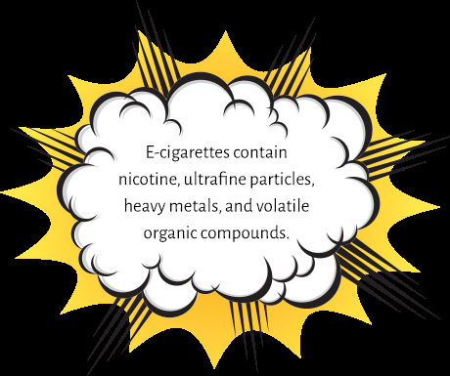
Notes:
Should policies include e-cigarettes? YES! It is not required by the HUD mandate, but individual PHAs have the authority to include e-cigarettes if they so choose.
Now you may be thinking right now – but aren’t e-cigarettes safer? Don’t they help people quit? But that’s not the question we’re asking today. We’re asking – should policies prohibit e-cigarette use indoors. And the answer to that is absolutely yes! We don’t want to compare indoor e-cigarette use to indoor secondhand smoke. We want to compare indoor e-cigarette use to clean indoor air. And we know that e-cigarette aerosol is worse for lungs than clean indoor air. E-cigarette aerosol has been found to contain nicotine, ultrafine particles, heavy metals, and volatile organic compounds. As an example, ultrafine particles can trigger asthma attacks and increased risk of heart disease.
U.S. Department of Health and Human Services. E-Cigarette Use Among Youth and Young Adults. A Report of the Surgeon General. Atlanta, GA: U.S. Department of Health and Human Services, Centers for Disease Control and Prevention, National Center for Chronic Disease Prevention and Health Promotion, Office on Smoking and Health, 2016.

Slide 23
L
I
S
T
E
N
T
O
U
S
Notes:
Presentations and meetings
One on one meetings with residents
Information on website, if you have one
Sending letters to homes
Include information in newsletters
Signage on community bulletin boards
For the first meeting, talk about the HUD rule and the benefit of smoke-free policies. Use the information in this presentation and handouts and you can always contact your local health department or us at the state for more information on secondhand smoke. A first community meeting might take awhile as some residents can be scared or angry what this policy change will mean for them. It’s OK if you don’t know the answer to a question; you can always tell a resident that you will find out the information and come back later with an answer.
We recommend meeting with the residents more than once over the course of the implementation period.
The smoke-free policy is considered a significant amendment to the PHA plan, so the policy will have to go before the Resident Advisory Board. And this meeting must be open to the public and be accessible for those with disabilities and limited English proficiency.
In PHAs that have gone smoke-free, individual meeting with residents were very well received. An explanation of the policy should be given as tenants resign their leases with the new smoke-free policy in them. If their lease is not up for renewal during the time before implementation, have each resident sign an addendum to their lease.
How do you usually communicate with residents?
What types of ways do they like receiving information?
Are there people who are hard to reach? What has worked well with them? What hasn’t worked well?
What resources can we at the state provide? Sample articles for newsletters? Resources in other languages?
Do you have any support residents who would serve as “smoke-free ambassadors?” and be willing to talk about why they are in favor of the policy? (Need to choose a good spokesperson, not just any person who likes to talk)

Slide 24
Notes:
Each resident will either have to sign a new lease with the smoke-free policy included or sign an addendum to their current lease with the smoke-free policy included.
As discussed earlier, you will have to decide whether you want to stick with the basic HUD policy or if you want to choose a more comprehensive policy. Your choices should be based on the science (re: e-cigarettes), feasibility for your properties, and also input from your residents. Their buy in will be important in making the policy stick.
Policy should state that failure to enforce any part of a smoke-free policy does not negate the right to enforce it in the future. Is this because we don’t want enforcement? No, it’s because it’s unrealistic to expect PHA staff and maintenance staff to be omnipresent and it is possible and likely they will miss someone violating policy. That doesn’t mean you should give up, nor does it mean other residents should ignore the policy. It means you’re human and to do your best.

Slide 25
Launch Your Policy
Host a Kickoff Event
Begin record keeping documenting violations.
Maintain open lines of communication with residents and staff regarding the policy.
Respond to all request for reasonable accommodation according to your protocol.
Continue hosting cessation classes.
Collect data to track the effectiveness of the smoke-free policy.

Slide 26
Contact Information
Elizabeth Anderson-Hoagland
Youth Policy Analyst
Tobacco Prevention and Cessation Program
Kentucky Department for Public Health
275 E. Main St. HS1 E-E
Frankfort, KY 40621
(502) 564-9358 ext. 4018
ElizabethA.Hoagland@ky.gov
www.tobaccofreeschoolsky.org
Terri Taylor
Second Hand Smoke Policy Analyst
Tobacco Prevention and Cessation Program
Kentucky Department for Public Health
275 E. Main St. HS1 E-E
Frankfort, KY 40621
(502) 564-9358 ext. 4023
Terri.Taylor@ky.gov
www.chfs.ky.go/dphmch/hp/tobacco

Slide 27
Smoke-free Policy Implementation
Amanda Bucher
Kentucky Center for Smoke-free Policy

Slide 28
Model Policy
Purpose of Policy
Decrease exposure to secondhand smoke
Decrease maintenance, cleaning, and redecorating costs from smoking
Decrease risk of fire from smoking
Define smoking: include cigarettes, cigars, pipes, and waterpipes (hookah)
Define boundaries: inside all buildings, 25 feet from buildings, balconies, patios, and decks are included
Specify Violations
Implementation Date

Slide 29
Violations of Policy
Define what is evidence of and what constitutes a violation
Resident complaint
Staff observation
Presence of tobacco product and/or paraphernalia observed during unit maintenance

Slide 30
Violations of Policy
Consider a ‘tiered’ approach including some or all of these steps:
Verbal warning (with active referral to tobacco treatment)
Written warning
Final notice
Grievance process
Goal is to create a healthier space, not to evict tenants.

Slide 31
3T’s Model: Tell, Treat, Train
Tell
Adequate and timely notification of changes to a policy is crucial
Clear communication about details of policy with tenants and staff
Lease agreement, staff handbook
Marketing the policy in a positive manner (signage, informative presentations)
Notes:
Welcome is important, why (healthy place to live, work, learn), what (smoke-free)

Slide 32
3T’s Model: Tell, Treat, Train
Treat
Nicotine replacement therapy
Freedom From Smoking classes
Quitline 1-800-QuitNow
Train
Have staff use scripting to approach violators in a clear, compassionate, and firm manner
Goal: Create an environment of policy compliance. Compliance is everyone’s responsibility.

Slide 33
Promoting Adherence: PHA Staff
Document tobacco use if observed during a unit visit
During regular inspections, make a record of tobacco ashes, used products, or smoldering tobacco products if observed
Provide tenants with guidance for reporting incidents they observe.
Define what should be reported:
Smell of smoke in the hallway?
Only observed smoking?
Date, time, location

Slide 34
Promoting Adherence: PHA Tenants
Create Tenant Advisory Board comprised of tobacco users
Encourage suggestions and feedback
Be clear that not all suggestions will be accepted but that you will listen to all ideas
Policy will only work if tenants feel they have a voice in policy implementation
Consider an anonymous reporting option
Ensure that your residents and staff will not face retaliation for reporting violations
Be careful not to encourage ‘spying’ on neighbors.

Slide 35
‘Train’: Scripting
Hello, my name is ______ and I am ______ (position) with the PHA. Are you aware that our property has a smoke-free policy? Smoking is not permitted anywhere inside or within 25 feet of the building. I ask you to please respect others and put your cigarette [or other tobacco product] out and dispose of it in that trash can.”
When they comply: Thank you for respecting others who live and work here.”
When appropriate, tell violators about nicotine replacement therapy and/or Freedom From Smoking classes available that can help individuals manage cravings while indoors.

Slide 36
Importance of Scripting
Using a consistent script leads promotes adherence to the policy– goal is to create an environment of compliance.
The script works! Over 90% will comply.
Make sure the same language is used with everyone: tenants, staff, visitors.
Use a firm, polite, and compassionate approach – stay positive and DO NOT apologize for the policy

Slide 37
Questions about Policy Implementation?
Contact me: 859-323-9958 amanda.bucher@uky.edu
Join our listserv: kcsp00@lsv.uky.edu
Visit our website: www.breathe.uky.edu

Slide 38
Resources to help implement smoke free policy and help with cessation
Notes:
Remind, we are a RESOURCE to help those who want to quit.
Not telling everyone they have to quit, they just have to follow the policy put in place ( 25 feet away or off property )
Some will take advantage and see this as an opportunity to quit.

Slide 39
https://www.hud.gov/program_offices/healthy_homes/smokefree
Notes:
How many have seen this?
I have very few copies
Go to the HUD.gov The Smokefree Multifamily Housing Resource Bank plus attached information to your HUD website

Slide 40
More Resources to Show Residents
Community Video Stories
http://www.lung.org/our-initiatives/tobacco/smokefree-environments/expanding-smokefree-communiti
A Mother's Asthma-friendly Housing Story
Breathing Easier at Home
A Fireman's Perspective
Smokefree Housing: Reaching a Property Manager
Mind & Body
Notes:
Lung.org has videos from residents who smoked before the implementation , residents who didn’t smoke but were breathing 2nd hand smoke, videos strictly for the property managers to coach you along the process. Again , attached to HUD website

Slide 41
WE ARE OFFERING:
SELF HELP BOOKLETS
FFS ON LINE REGISTRATIONS
IN PERSON CLINICS WITH NICOTINE REPLACEMENT PRODUCTS & HEALTHY SUBSTITUTION KITS
QUITTERS CIRCLE APP
TRAINING : TOBACCO 101 or
FACILITATOR TRAINING
Notes:
I have 100 Self Help Books with me
Studies have shown in person/ NRT
On line FFS plus, normally $99 for a year/ we can give your residents for free ( coaching on line and by telephone, desk top tablet smart phone, can chat with help line via phone, text, email………
Clinics and supplies with NRT
Plus help in utilizing Insurance to pay for NRT
Tobacco 101 : a training so you’ll be able to talk to residents with a baseline of knowledge about tobacco
Full on Facilitator Course

Slide 42
UPCOMING FACILITATOR TRAINING:
FEB. 28 GRAVES CO
MARCH 13 BOYD CO
MARCH 28 LEXINGTON
APRIL 11 LOUISVILLE

Slide 43
Contact Us
tami.cappelletti@lung.org American Lung Assoc. in KY

